Slide 1

Digital Portfolio
STUDENT NAMEJANETGRACE.A REGISTER NO AND
NMID:6DC2BB26294B90FA19A4049B6EF83D01 DEPARTMENT:B.SC COMPUTER SCIENCE COLLEGE: SRM ARTS AND SCIENCE COLLEGE UNIVERSITY:MADRAS UNIVERSITY

Slide 2


PROJECT TITLE
Digital portfolio

Slide 3




AGENDA
Problem Statement
Project Overview
End Users
Tools and Technologies 5.Portfolio design and Layout
Features and Functionality
Results and Screenshots
Conclusion
Github Link
3
3/21/2024 Annual Review

Slide 4

PROBLEM STATEMENT
In today’s competitive world, having only a resume is not enough to showcase skills and achievements.
Many students and professionals struggle to present their projects in an attractive way Traditional resumes fail to highlight creativity and technical abilities effectively.
A well-structured portfolio can act as a digital identity for individuals.
The problem is the lack of a simple and professional solution for this need.
This project focuses on solving that by creating a portfolio website.
It helps individuals stand out and create a better impression.

Slide 5


PROJECT OVERVIEW
A Project Overview PPT is a short presentation that provides a clear summary of a project. It explains the project’s objectives, scope, and expected outcomes in a simple way. The PPT usually highlights the timeline, milestones, deliverables, and resources needed. It also introduces the project team and stakeholders involved. Often, it includes possible risks and how they will be managed. This helps everyone quickly understand the purpose, progress, and next steps of the project.

Slide 6

WHO ARE THE END USERS?
The end-user is the person who ultimately uses a product, system, or service. They are important because the success of any project depends on meeting their needs and expectations. End-users help in identifying requirements during planning. Their feedback guides improvements and ensures usability. If the end-user is not satisfied, the project may fail even if it is technically sound. Therefore, involving end-users in design and testing is essential. They represent the true measure of a project’s effectiveness.

Slide 7


TOOLS AND TECHNIQUES
This project uses fundamental web development tools and technologies. HTML provides the structure of the website, while CSS is applied for design and styling. JavaScript is included to add interactive elements and improve functionality. Coding is carried out using a text editor such as Visual Studio Code. GitHub is used for hosting and sharing the project online. Browser developer tools assist in testing and debugging the final design.

Slide 8


POTFOLIO DESIGN AND LAYOUT
A portfolio design and layout refers to the way content is arranged and presented to showcase skills, projects, or achievements. A good layout should be clean, professional, and easy to navigate. It usually includes sections like an introduction, work samples, skills, and contact details. The design must highlight strengths without looking cluttered. Consistent fonts, colors, and spacing improve readability. Visuals such as images, charts, or icons make the portfolio more engaging. A well-structured portfolio leaves a strong impression on viewers or employers.

Slide 9

FEATURES AND FUNCTIONALITY
Features are the specific characteristics or attributes of a product, system, or service, such as tools, design elements, or options provided. Functionality refers to how those features work and what tasks they allow the user to perform. Together, they define the value of a product for the end-user. Strong features attract attention, but effective functionality ensures usability and satisfaction. For example, a camera’s feature might be “high resolution,” while its functionality is “capturing clear, detailed images.” Balancing both is essential for a successful product.

Slide 10

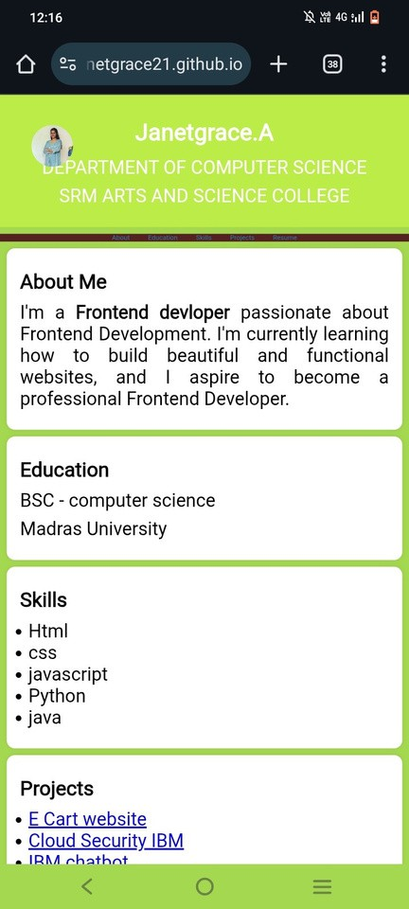
RESULTS AND SCREENSHOTS
The final portfolio website is fully functional and responsive.
Screenshots show different sections like Home, About, and Projects.
1
0

Slide 11

CONCLUSION
The project successfully solves the problem of professional
The project successfully solvesp trhees epnrtoabtlieomn. of professional IItt ccrreeaatteess aa ssttrroonngg oonnlilninee pprreesseennccee ff TThhee ppoorrttffooliloio isis eeaassyy ttoo uussee, , wweelll-l-ddeess IItt hheelplpss inin ppeerrssoonnaal l bbrraannddiningg aanndd ccaa TThhee ddeessigignn aanndd ttoooolsls uusseedd mmaakkee itit ssim FFuuttuurree imimpprroovveemmeennttss ccaann ininccluluddee aad IItt sshhoowwss tthhee imimppoorrttaannccee ooff aa ddigigititaal l

Slide 12
GitHub link
https://janetgrace21.github.io/Janetgrace.A/

Slide 13

Thanking you

